Slide 1
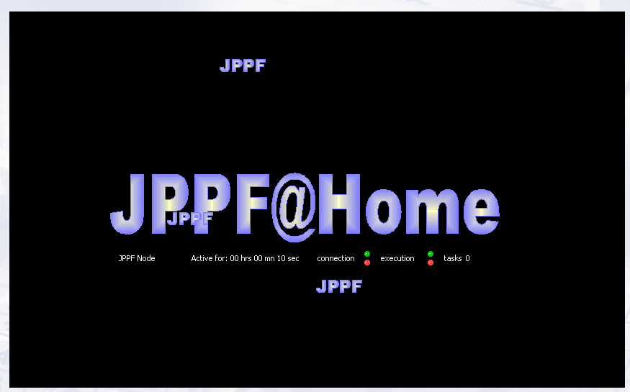
Java Parallel Processing Framework

Slide 2
Presentation Road Map
What is Java Parallel Processing Framework
JPPF Features
JPPF Requirements
JPPF Topology
JPPF Programming
JPPF API
JPPF and Networking

Slide 3
Java Parallel Processing Framework
It is a grid toolkit (library) for Java that makes it easy to run your applications in parallel.
JPPF is an open source Grid Computing platform written in Java that makes it easy to run applications in parallel, and speed up their execution by orders of magnitude. Write once, deploy once, execute everywhere!

Slide 4
JPPF features
A JPPF grid can be up and running in minutes
Simple programming model that abstracts the complexity of distributed and parallel processing .
Highly scalable, distributed framework for the parallel execution of cpu intensive tasks.
Seamless integration with leading J2EE application servers .
Graphical and programmatic tools for fine-grained monitoring and administration
Fault-tolerance and self-repair capabilities ensure service and reliability .
A set of fully documented sample applications of JPPF to real-life problems
Very flexible and business-friendly open source licensing

Slide 5
JPPF 1.8 installation
Requirements
Any platform with Java 2, Standard Edition (J2SE) 5.0 or later.
Apache Ant 1.6.2 or later. At least 512 MB of RAM.
The latest version of the JPPF source code. It can be found on
the JPPF download page. The name of the file should be jppf-full-src-x.y.z.bbbb-yyyymmdd.zip

Slide 6
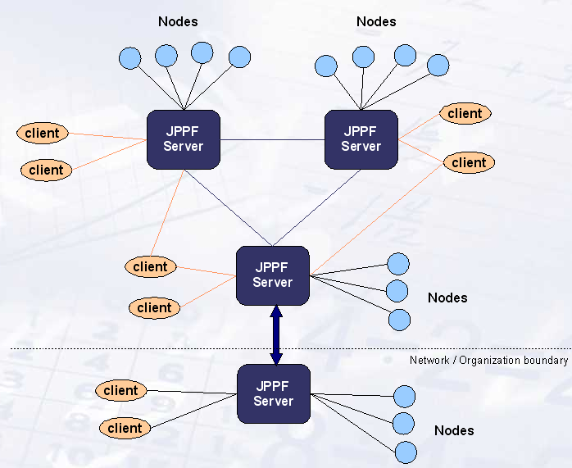
JPPF Topology

Slide 7
JPPF Topology Features
JPPF can be extended to include many servers, communicating together in a peer-to-peer topology.
In this topology, each server is seen by its peers as a node, and sees its peers as clients.
There are a number of major advantages to this design:
It enables a greater scalability of the JPPF grid, by allowing the "pluging-in" of additional servers dynamcally. This way, a server can delegate a part of its load to other servers.
No matter how many servers are present, nodes and clients communicate with them in the exact same way
Peer server connections benefit from the same failover and recovery features available to nodes and clients

Slide 8
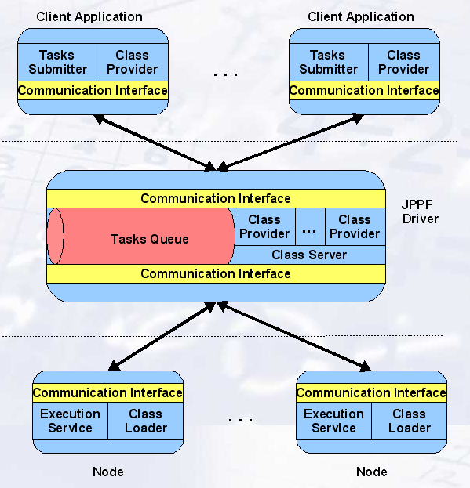
JPPF High Level Architecture

Slide 9
JPPF Supported Platforms
Operating Systems
JPPF will work with any OS supporting a Java JVM 1.5.0 or later, including:
Linux and Unix platforms (32 and 64 bits)
Windows 2000, XP, 2003 (32 and 64 bits)
JVM
JPPF has been tested witth he following JVMs:
Sun JDK 1.5.0
Sun JDK 6
IBM JVM 1.5.0

Slide 10
JPPF Programming
Client Implementation
The client has to split up the calculations into pieces that are executed in a single server node, and pass them to the JPPF framework. The atomic portions that are executed in a JPPF node are called tasks. It is up to the client application to define a reasonable part of the complete algorithm as a task. Small tasks may cause a high transport overhead, while large tasks may cause poor parallelism in execution.

Slide 11
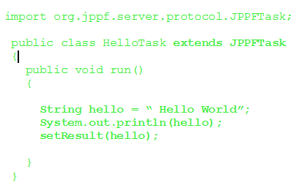
JPPF Programming
A task that can be submitted to the JPPF framework for execution must be a specialization of the JPPFTask. It must at least implement the run() method. The run() method contains the code that is executed in a JPPF node.
The run() method must store the result of the calculation using the setResult() method.

Slide 12
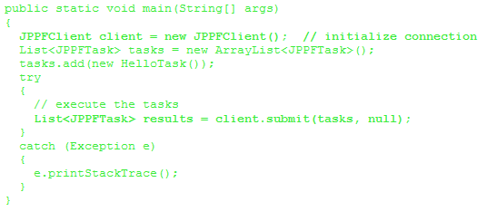
JPPF Programming
Task Submission
Tasks are submitted to the JPPFClient instance as a List of JPPFTask instances. The list is passed to the submit() method, and a List of JPPFTask instances is returned, containing the results.

Slide 13
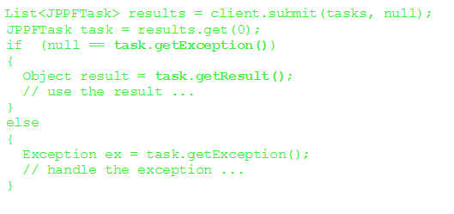
JPPF Programming
Task Results
The result of a submission of a task list is returned by the submit() method. Each of the returned JPPFTask instances contains the result of this specific task, or the Exception if the execution failed.

Slide 14
JPPF API
JPPF provides API that unifies the way to write a JPPF
tasks and to submit tasks and obtain tasks execution
results.
This are some JPPF package include classes that contain important
JPPF API
Org.jppf.client
Org.jppf.client.JPPFJob
Org.jppf.server
Org.jppf.node
Org.jppf.security

Slide 15
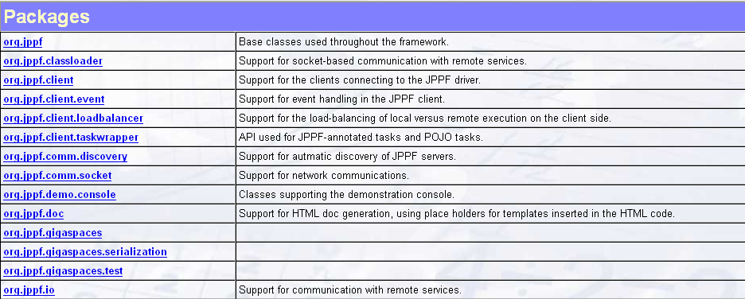
JPPF API
All Classes are found in JPPF documentation page

Slide 16

JPPF driver and administration monitoring
JPPF node and task monitoring
it is now possible to receive notifications from the nodes or from tasks being executed.
Connection status
Execution status
Set of methods that monitor node and task

Slide 17
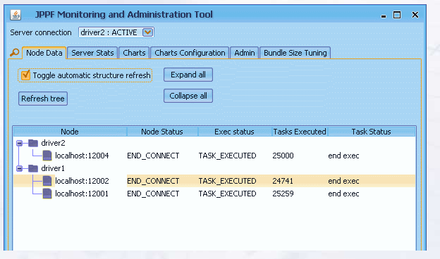
JPPF driver and administration monitoring
Monitoring Tool

Slide 18
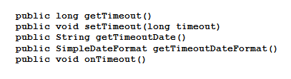
JPPF driver and administration monitoring
Administration Support
Task timeout: tasks are canceled after a given amount of
time or at a specific date/time .
Task cancellation and restart .
Set of methods that task administration

Slide 19
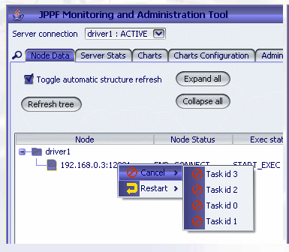
JPPF driver and administration monitoring
Administration Tool

Slide 20
JPPF Resource Adaptor
The JPPF Resource Adapter is JCA-compliant resource
adapter module that encapsulates a JPPF client.
It provides J2EE application servers with an access to JPPF grid services.
It is intended for deployment as either a standalone module or embedded within an enterprise application, while preserving the ease of use of JPPF.

Slide 21
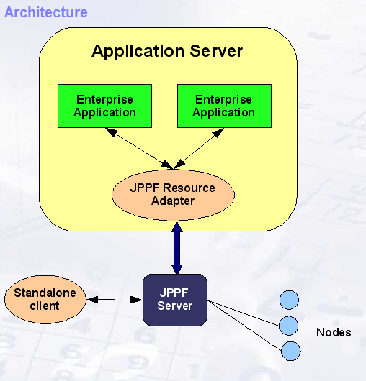
JPPF Resource Adaptor

Slide 22
JPPF Resource Adaptor
Resource Adaptor Features
Supports a pool of connections to a single JPPF driver
Supports disconnection from, and reconnection to, a JPPF driver
Compliant with the JCA 1.5 specifications
API similar to that of the standard JPPF client (submit(tasks, dataProvider))
No transaction support

Slide 23
JPPF And Networking
The TCP port multiplexer
JPPF requires at least 3 TCP ports to function. In network environments where a policy imposes the use of a firewall, these ports will generally be blocked, preventing any traffic through unauthorized ports. This situation is very common, and in the case of JPPF, is very difficult, even nearly impossible, to work around. To address this situation, we have implemented a tool called TCP port multiplexer, that enables the routing of network traffic from multiple ports to a single port on one side, and the routing of the same traffic from a single port to multiple ones on the other side. With this tool, it becomes possible to work with JPPF in firewalled environments, without having to deploy a complex hardware/software infrastructure.

Slide 24
JPPF And Networking
To understand how the multiplexer works and how it integrates with a JPPF grid, let's take the example of a typical JPPF configuration:
The JPPF client, server and node are all on separate machines and use the default ports 11111, 11112 and 11113
The network environment includes a firewall that will only let traffic through port 443

Slide 25
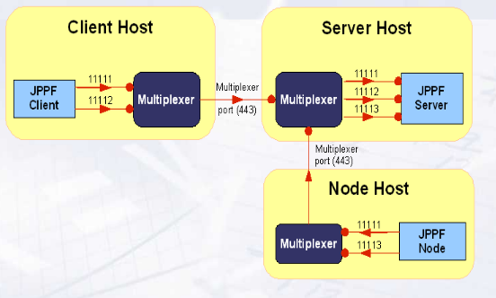
JPPF And Networking
JPPF and network Architecture
A directed red arrow represents an incoming connection. The small circle at one end means that the corresponding component is listening for connections on the specified port.

Slide 26
JPPF And Networking
This architecture bears a number of remarks:
Nodes and clients connect to the multiplexer as if it were a local JPPF server
The JPPF server accepts connections from the multiplexer as if they came from local clients and nodes
The multiplexing and demultiplexing of the network traffic is completely transparent to the JPPF components
As additional network routing steps are added, a performance decrease should be expected, compared to a non-multiplexed JPPF grid
In this configuration, management and monitoring of the nodes and server is not possible, and should be disabled for the nodes and servers behind a firewall

Slide 27
JPPF And Networking
Multiplexer Configuration
The multiplexer plays a different role, depending on whether it is on the JPPF
server machine or not:
A multiplexer on a JPPF server host only needs to listen to connections on a multiplexing port
A multiplexer on a JPPF client or node host binds to the JPPF ports, as if it were a server. It needs to know which ports to bind to, and for each bound port which remote multiplexer to route the traffic to.

Slide 28
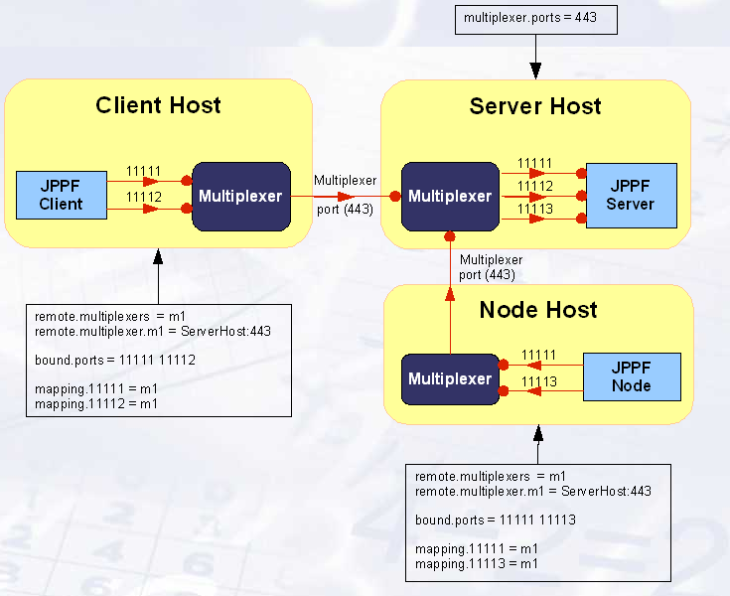
Multiplexer Configuration

Slide 29
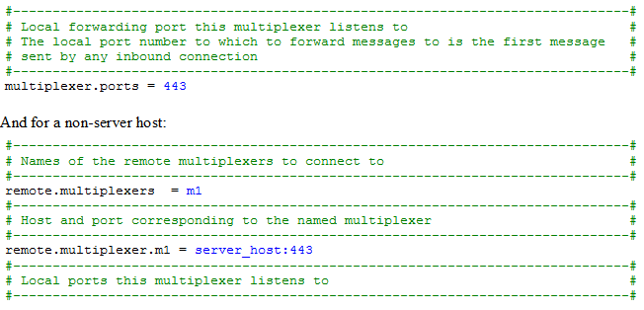
JPPF And Networking
Full Multiplexer Configuration Example For Server Host:

Slide 30
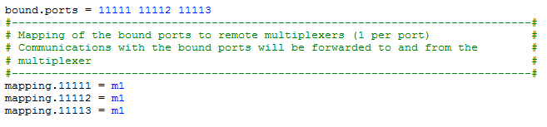
JPPF And Networking

Slide 31
Java Parallel Processing Framework
Reference
www.sourceforge.net
www.JPPF.org

